Slide 1
Execution Planning for Success
Arthur Daniels

Slide 2
Intro
2 years as a BI Developer
1 year as a Database Administrator
Attended PASS Summit 2015 + 2016
“I don’t care how long my query takes as long as it returns results”

Slide 3
DBA-Art.com Twitter: @ArthurDanSQL
Presentation slides + demos
Step-by-step instructions for setting up a test server at home:
http://www.dba-art.com/setup-local-sql-server/

Slide 4
Overview
What makes up an execution plan?
What do the operators inside the execution plan mean?
What you can infer from your plan

Slide 5
My test environment
16 GB of RAM
SQL Server 2014
8 CPU cores
Spinning disk HDD 1 TB
Running AdventureWorks2014 Database

Slide 6
Your environment matters
Hardware
SQL Settings
Min Max Memory, Cost Threshold for Parallelism
SQL version

Slide 7
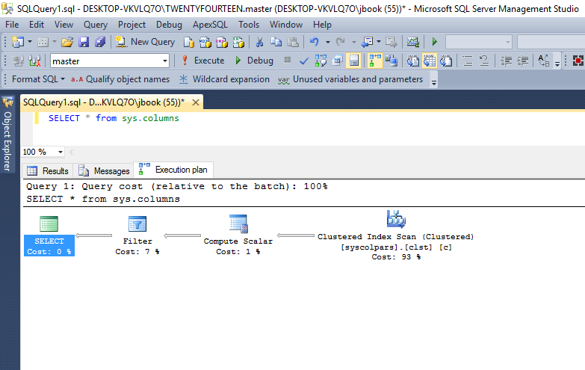
Graphical Execution Plan
What’s that?

Slide 8
Where?
Graphical Execution plans are stored as XML
SQL Server Management Studio (SSMS)
Estimated
Actual
SQL Server Plan Cache

Slide 9
Graphical Execution Plan
Plan Operators
Index Seek Index Scan

Slide 10
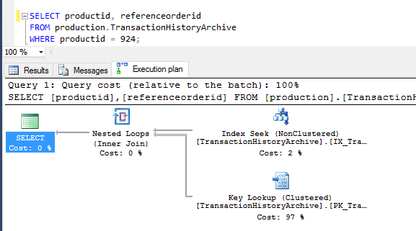
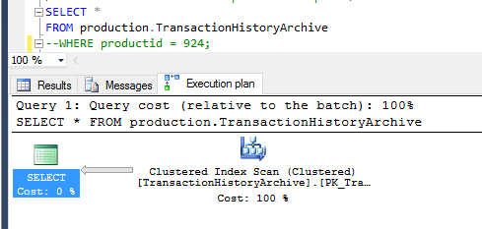
Other execution plan features
Flow and size of line

Slide 11
The Plan Cache
sys.dm_exec_cached_plans (2008)
Plan cache contains estimates
Emptied when server restarts

Slide 12
Plan cache demo
To-do:
Build plan cache
Find our specific plan
Look at operator

Slide 13
Where do the estimates come from?
SQL Server automatically generates statistics
One statistic per index
One statistic per column once a query searches by that column
Search as in Where clause, JOINs

Slide 14
Statistics Demo
Open Statistics on IX_TransactionHistoryArchive_ProductID

Slide 15
Statistics General
Used for execution plan estimates
Automatically generated
One for each index
One for each column*
Statistics contain header, density vector and histogram

Slide 16
Reading deeper
Parallelism as operators
Gather Streams Distribute Streams Repartition Streams

Slide 17
Comparing a parallel query to serial query
Demo
Set Cost Threshold for Parallelism to 1 for this demo

Slide 18
Compute Scalar Operator
Used for mathematical expressions
Referred to as “Expr”

Slide 19
Compute Scalar Demo
Demo here

Slide 20
Implicit Conversion
Why?
In actual and estimated

Slide 21
Reading Implicit Conversions
Demo

Slide 22
Missing Index Hints
Execution plan will contain index suggestions
Only the first missing index is shown

Slide 23
Missing Indexes
Demo

Slide 24
Wrap-Up
How SQL estimates cost
Operators:
Index Scan, Index Seek
Parallelism
Compute Scalar
Implicit Conversions
Missing Indexes

Slide 25
Finally, what you can infer
Look at size of lines between operators
Discover what operators are doing
Search your plan cache for hidden problems

Slide 26
Questions?
You can also contact me on Twitter, @ArthurDanSQL or my website, www.DBA-Art.com

Slide 27
Useful links
Finding Implicit Conversions in your Plan Cache
Free graphical plan explorer:
https://www.sentryone.com/plan-explorer/

